Slide 1
Happiness and Superheroes
With Batman and Timuel D. Black

Slide 2
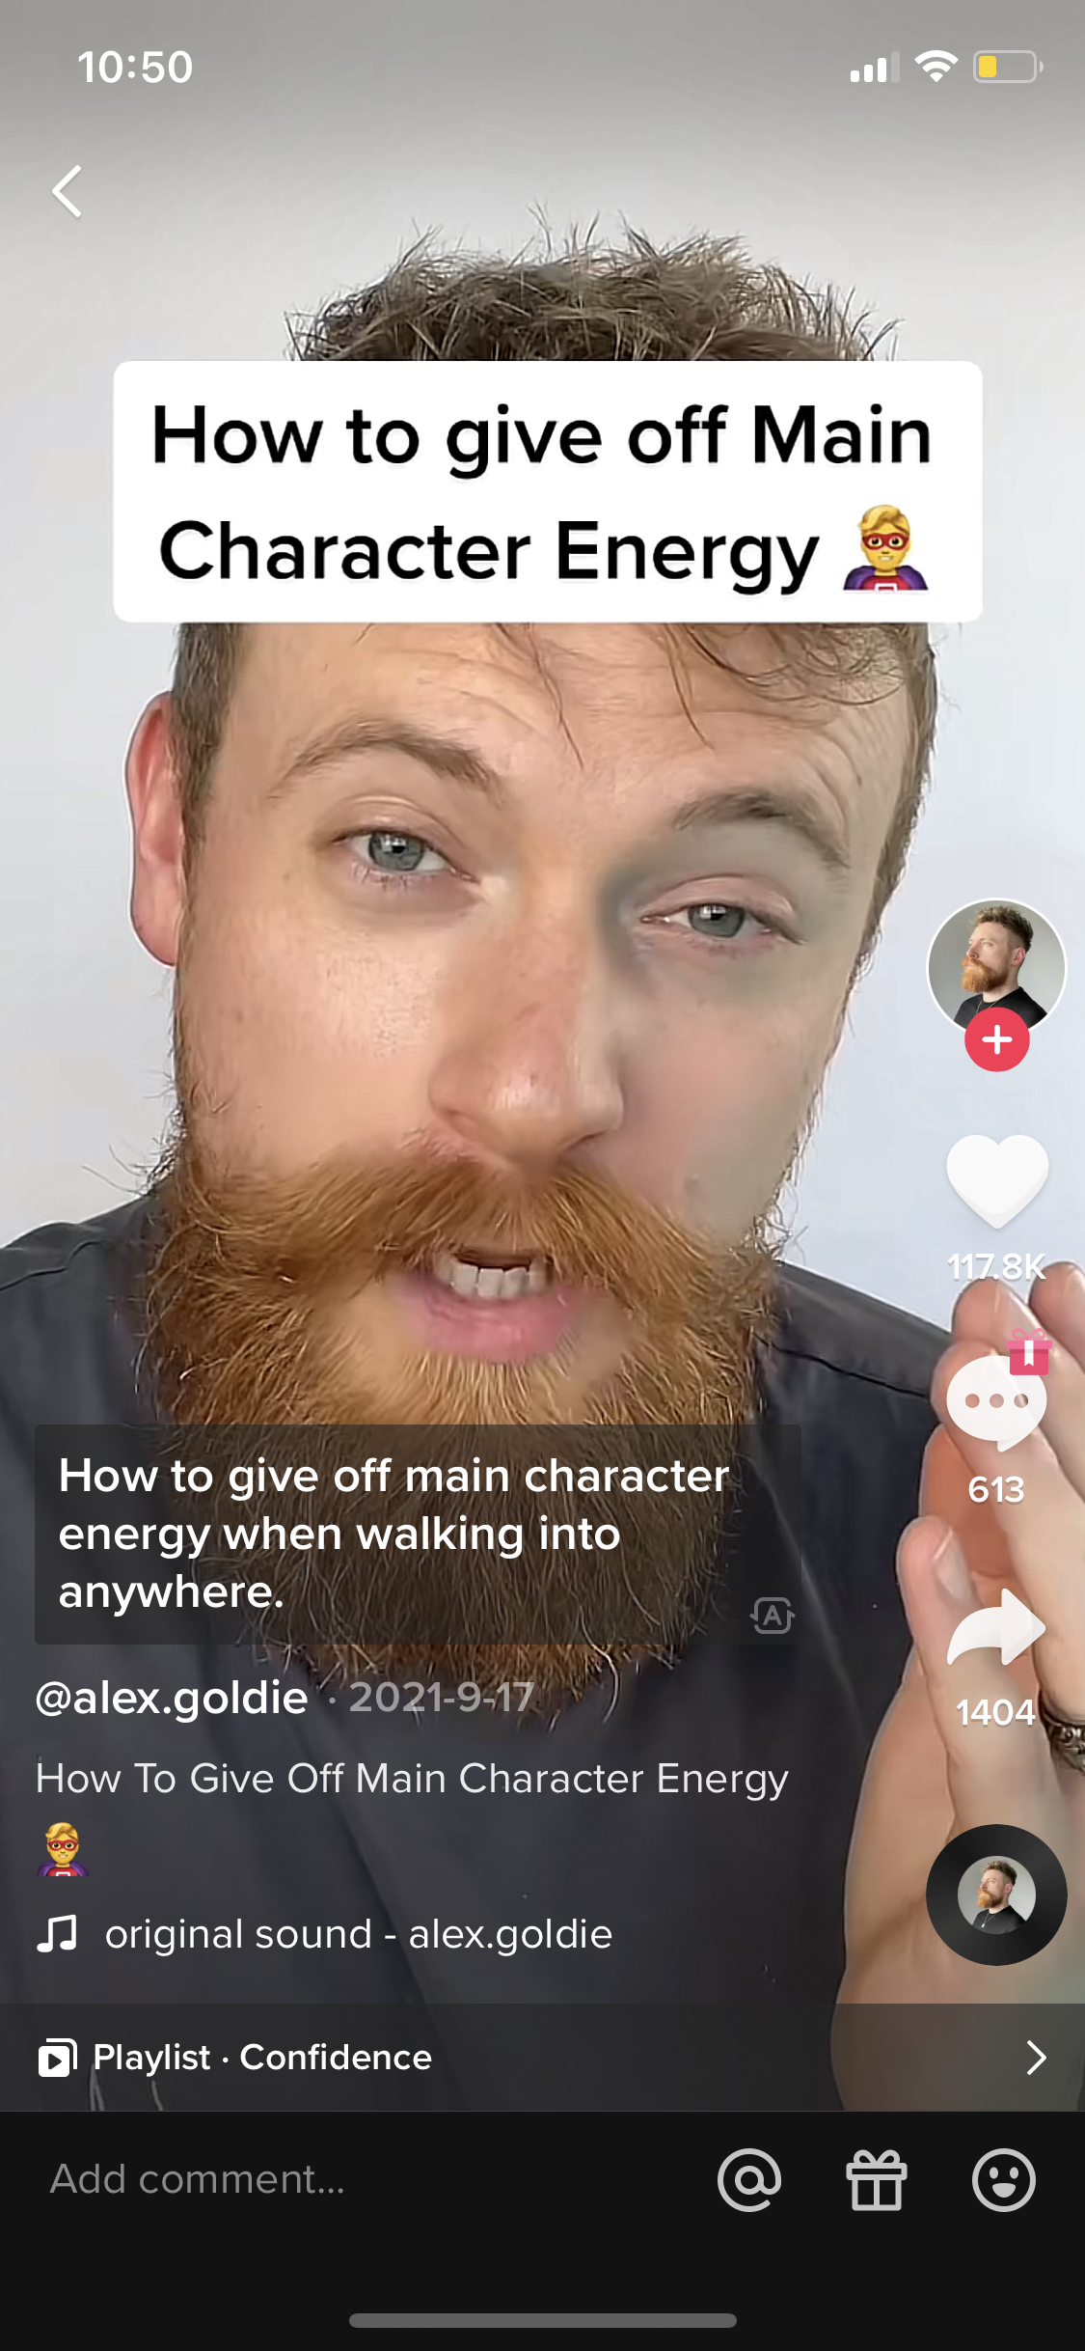
Why Superheroes?
Notes:
First, I wanted to provide some motivation for this presentation – why specifically superheroes?
Recently, there’s a trend in popular culture “main character energy” - where basically you try to affirm that you are the main character of your life or even other people’s lives. There're endless examples of content related to this, so here we have "becoming an main character

Slide 3
Why Superheroes?
Notes:
Idea of destiny because you are the main character

Slide 4
Guiding Questions
Does considering yourself the the superhero or main character of your life facilitate/obstruct your pursuit of authentic happiness?
How do superhero narratives impact the way we construct a story with our lives?
What is problematic about media portrayal of superheroes? (Hint: a lot)
Notes:
Is it damaging to your happiness to think of yourself as the superhero or protagonist of your life? How does this change the way we tell a story about our lives?
Argue that the main character energy symbolized by superheroes is problematic and provide food for thought for some critical distance when you watch the next superhero movie

Slide 5
Table of Contents
History of superheroes
Golden Age & political depression
Silver Age & Psychological Depression
Tim Black v.s Batman

Slide 6
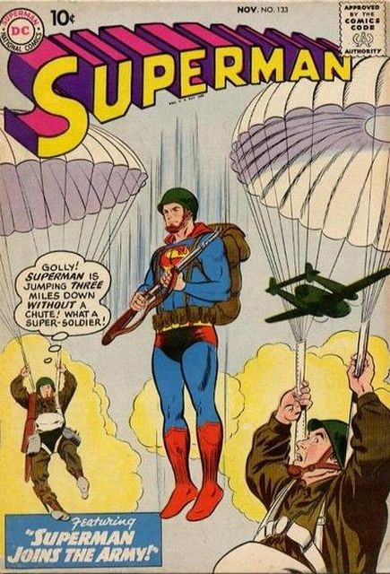
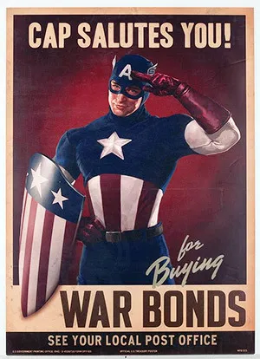
A Brief History of Superheroes
Golden Age (1938-54)
Superman (June 1938)
Crimson Avenger (Oct. 1938)
Sandman (April 1939)
Batman (May 1939)
Silver Age (1956-69)
Many superheroes were almost cancelled
1960s: Marvels’ ‘flawed superheroes’ brought them back e.g Amazing Spiderman is basically an angsty teen
Bronze & Modern Age (1970-80)
Notes:
Although the term ‘superhero’ was used as early as 1917 to describe a public figure of great talents or accomplishments, it was not until the 1940s when the modern conception of superhero was born
Fun fact: In the very first Captain America comic book there’s a scene where he’s literally punching Adolf Hitler in the face, and then in the 1950s he was recast as “Captain America: Commie Smasher”
The golden age of superheroes coincided with times of war and economic depression
Two points I want to make with this:
1. Political depression and superheroes; individualism -> politically problematic
2. Modern superheroes all have a sad backstory; pain and trauma somehow makes them better and more virtuous (Nietzsche?) and deserving of greater things

Slide 7
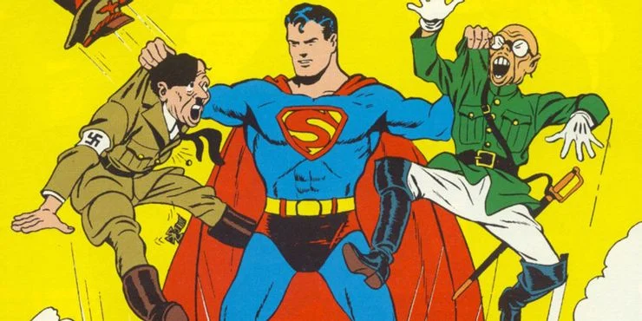
Superman grabbing Adolf Hitler and Prime Minister of Japan, General Hideki Tojo by their collars, cover of issue #17

Slide 8
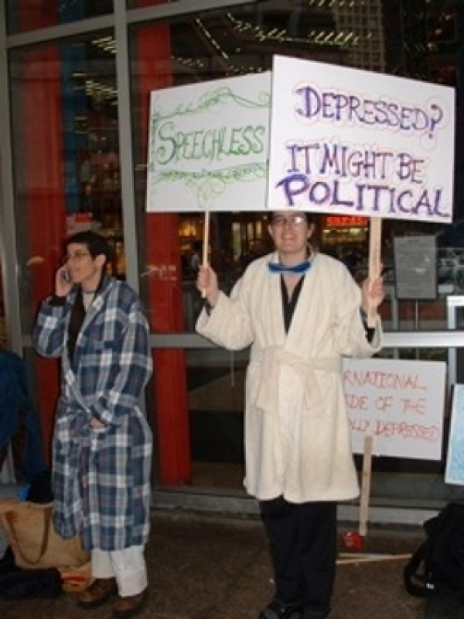
1. Golden Age: Superheroes & Depression (Environment)
Superheroes rose to popularity during a time of depression and deprivation.
“Misery might also have a public dimension, and hence a political one (Segal, Radical Happiness)”
“The joys of living, the manifold small pleasures that leaven our days... are substantially foreclosed when we are stressed” (Haybron, Additional Selections on Central Affective States)
“No one could be called either happy or free without participating, and having a share, in public power” (Arendt, On Revolution)
Feel Tank Chicago, 2003
Notes:
both political (Segal) and psychological (Haybron)
Segal then talks an example of political depression: she writes about the sense of helplessness, failure, depression and anxiety experienced by people who tried to prevent the election of Bush and the military invasion. Political depression occurs when you are forced to recognize the limits of your power -- which is one individual during wartime.
To bring in more of Haybron’s theory. Haybron’s three theory consists of three areas, attunement, engagement, endorsement. All of these three are nearly impossible during wartime. Taking attunement as an example, here is what Haybron writes :. The three components of attunement are tranquility, confidence and expansiveness. During war, there is the constant threat of unknown danger, uncertain victory,
Two points I want to make with this:
1. Political depression during the golden age of superheroes; individualism -> politically problematic. Superheroes were born out of a desire to see good triumph over evil.
2. Psychological trauma during the silver age of superheroes: all superheroes have a sad backstory; pain and trauma somehow makes them better and more virtuous and deserving of greater things

Slide 9
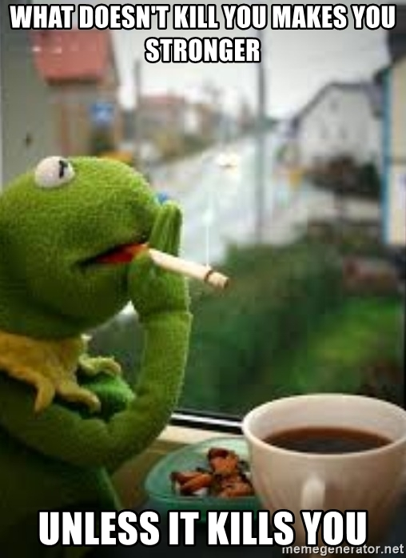
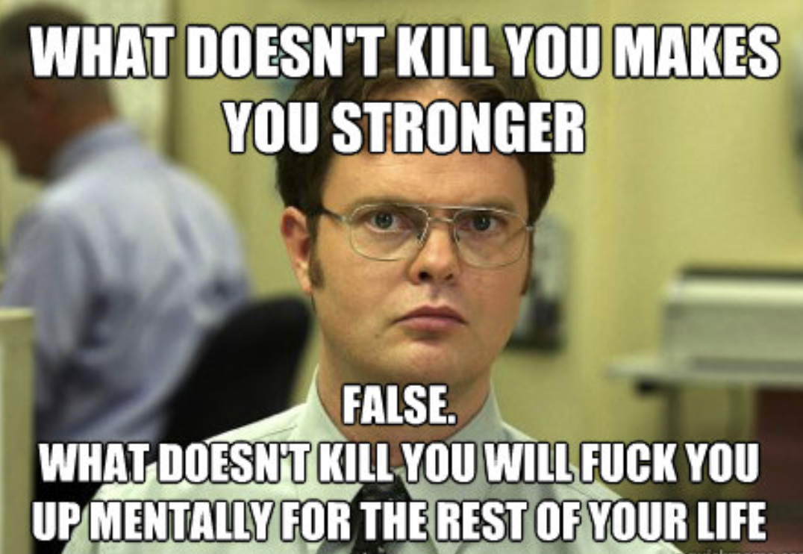
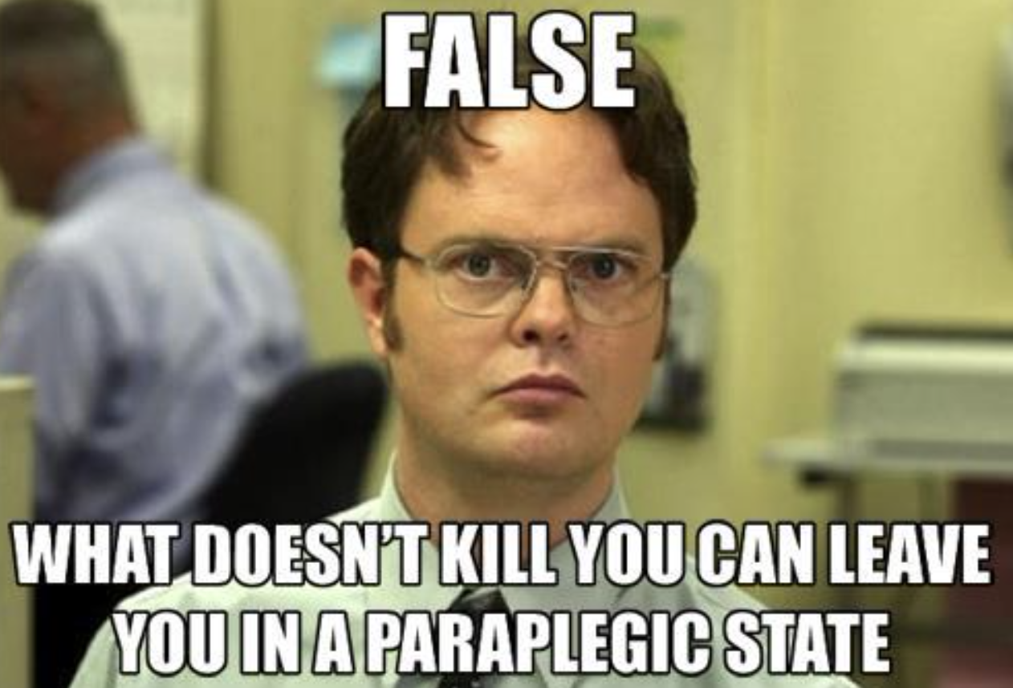
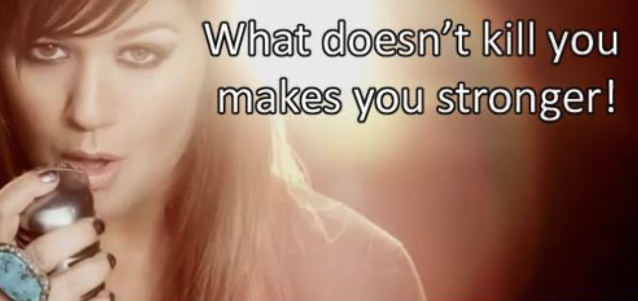
2. Silver Age: Superheroes & Depression (Character Psychology)
“Many are coming to define themselves by their pains: past traumas, mental illnesses, and chronic health conditions” (Davies, The Age of Pain)
Superman, Batman, Hulk, Storm, Electro
Davies on depression and capacity “Depression is just sheer incapacity, a distinctly neo-liberal form of psychological deficiency, representing the flipside of an ethos that implores individuals to act, enjoy, perform, create, achieve and maximize”(Davies, The Political Economy of Unhappiness)
A problematic relationship between our trauma and our strengths, where our identity is characterized by some core internalized trauma
Notes:
In Segal’s analysis of Davis quote, she then goes on to say there are “diametrically opposed” methods of doing this – you can share find commonality with your people and transform this into a shared cause, or bear this alone
Superheroes are the opposite of incapacity - they symbolize power and autonomy,
What is the story that superheroes tell?
Internalized depression or trauma makes you stronger; you are able to act and become powerful due to what you have suffered
where our identity is defined by our some core internalized trauma. “What doesn’t kill you makes you stronger” – a way of legitimizing and justifying the bad things that happen to you as being good in the end

Slide 10
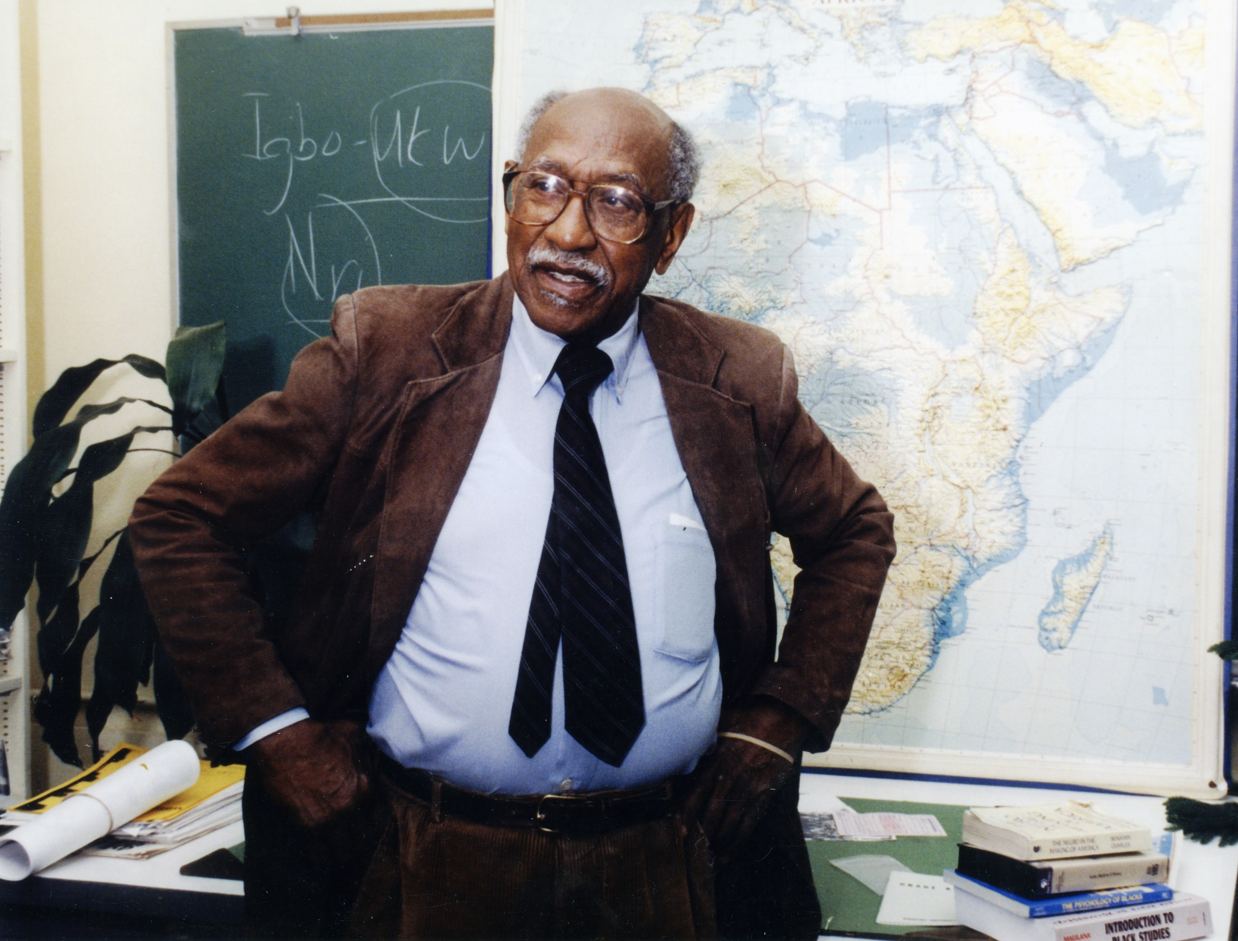
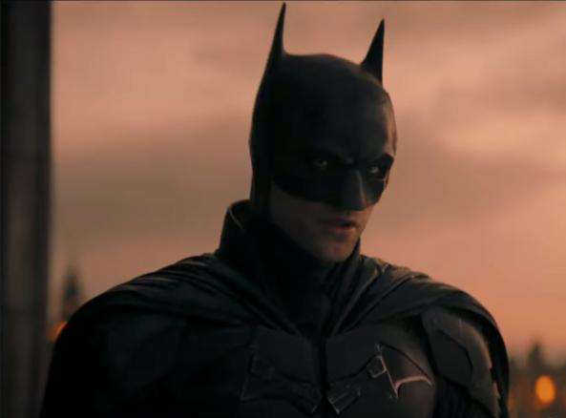
Batman and Timuel D. Black: Who is Happier?
Motivation, Relationships, Power
Notes:
Both fought for social justice at work? When the director Nolan created Batman, he said he wanted to emphasize, ““[i]n America we take for granted a stability to our class and social structure that has never been sustained elsewhere in the world” – in other words, the struggle of society against injustice and chaos
To be clear, Tim Black was not someone who saw themselves as a superhero or atypical in any sense (although I think he is in the best possible way). On page 7, he says ”my story’s typicalness is precisely where its value lies”
”When you win you don’t know what to do”
Tim’s way of telling his story with the war v.s people who see war as the meaning of their lives (lost meaning if his causes triumph)

Slide 11
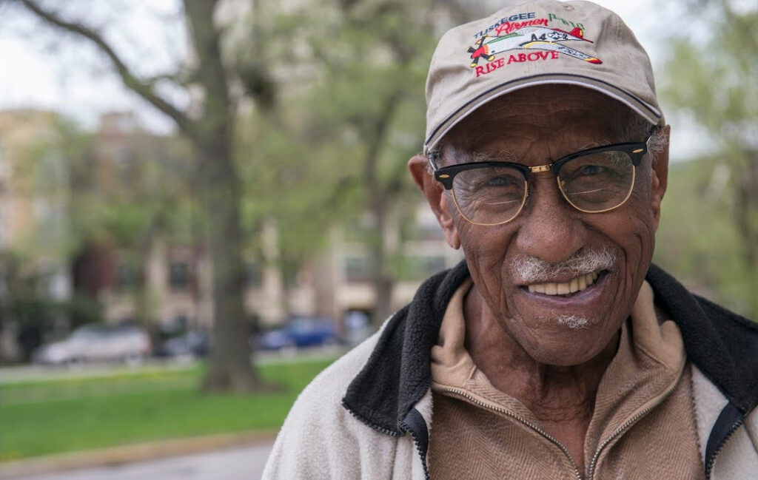
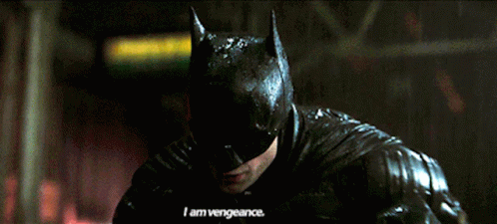
1. Call to action: motivation
Vengeance
Love
“I’m a dog chasing chars. I wouldn’t know what to do with one if I caught it!”
(The Dark Knight 1:48)
“I hope, too, that you’ll come to understand why I feel so much love for my sacred ground.”
“We can, in different ways, fall in love with ideas, ideals, places, sounds, anything that inspires and uplifts us.” (p.154, Segal)
Notes:
Batman’s psyche – aimed at vengeance (Achilles)
“We had paid our dues, worked hard, served our country in two world wars, built businesses, and provided the nation with some of its finest and best-loved entertainment. But the city and the schools were run by men who didn’t like us, and in some instances despised us..” (p.99, Sacred Ground)
Segal goes on to say – “what we love inspired in us a sense of ontological rootedness”. Without love, “both your soul and your whole world might subsist forever in some desert-like state of ontological impoverishment”, and the things we love confirm our existence ad make

Slide 12
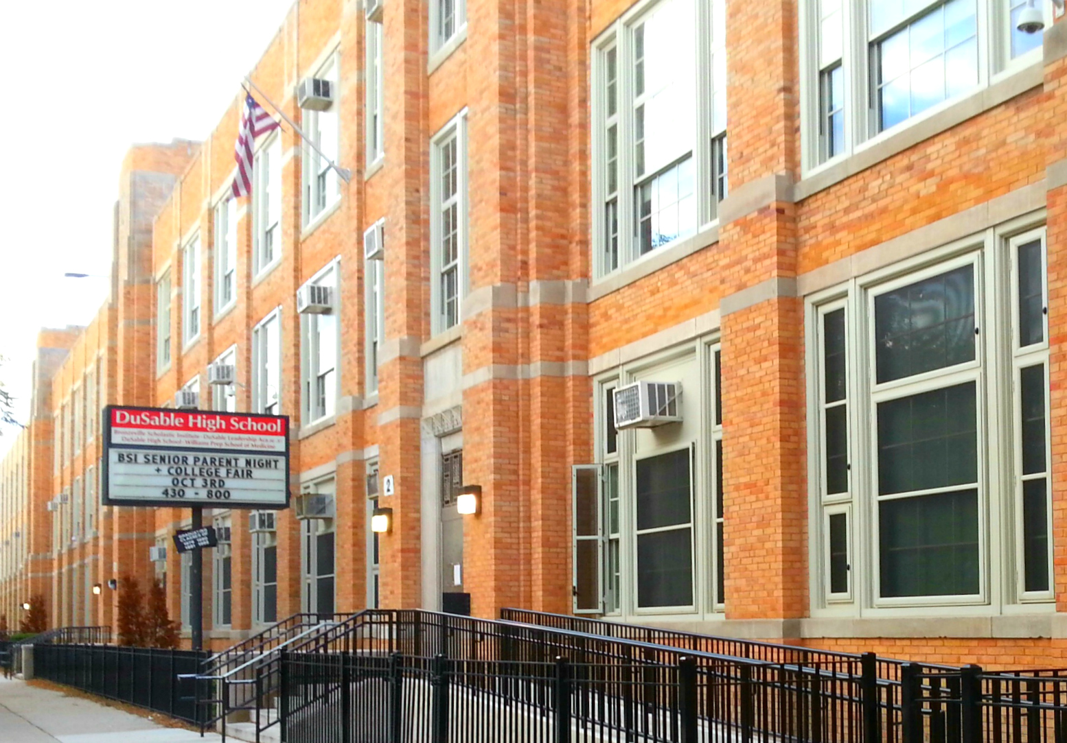
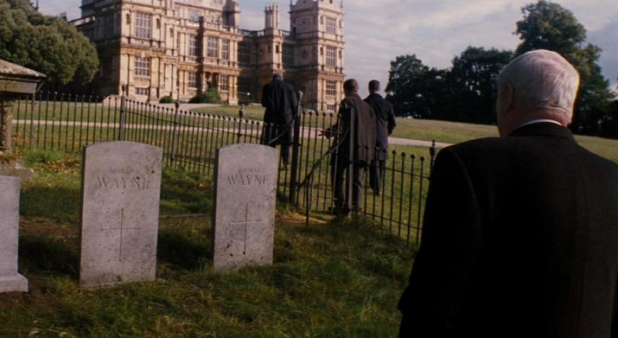
2. Helper, mentor: relationships
Batman had individual relationships, (Alfred, Gordon, Rachel, Selina) but no community
Parallel institutions, parallel economy, parallel social spaces
Neighborliness “There was always a neighborhood identity and a feeling of neighborliness” (Black)
Notes:
Alfred
Batman = loner, Tim belongs to a commuinity
when he fails or triumps he’s alone
“Within the Black Belt, we created these parallel economic institutions – essentially we build a parallel economy”
“With a sprawling extended family of aunties, uncles, and watchful neighbors”
“There was always a neighborhood identity and a feeling of neighborliness”
“Nor was there a psychological feeling of depression. It was the Depression but we were not depressed.”
“Anyway, the whole black population of Champaign came out to see us play. We lost, but amongst the blacks we were heroes. That sense of community, of mutual support, was so important.” (23)

Slide 13
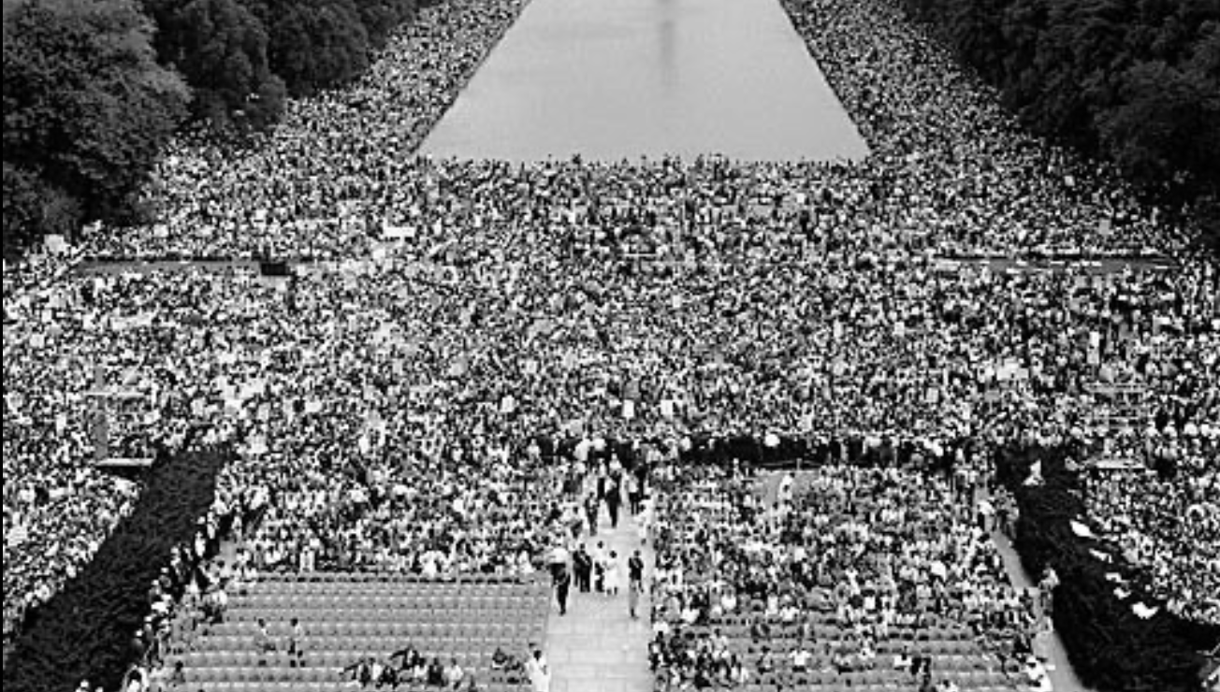
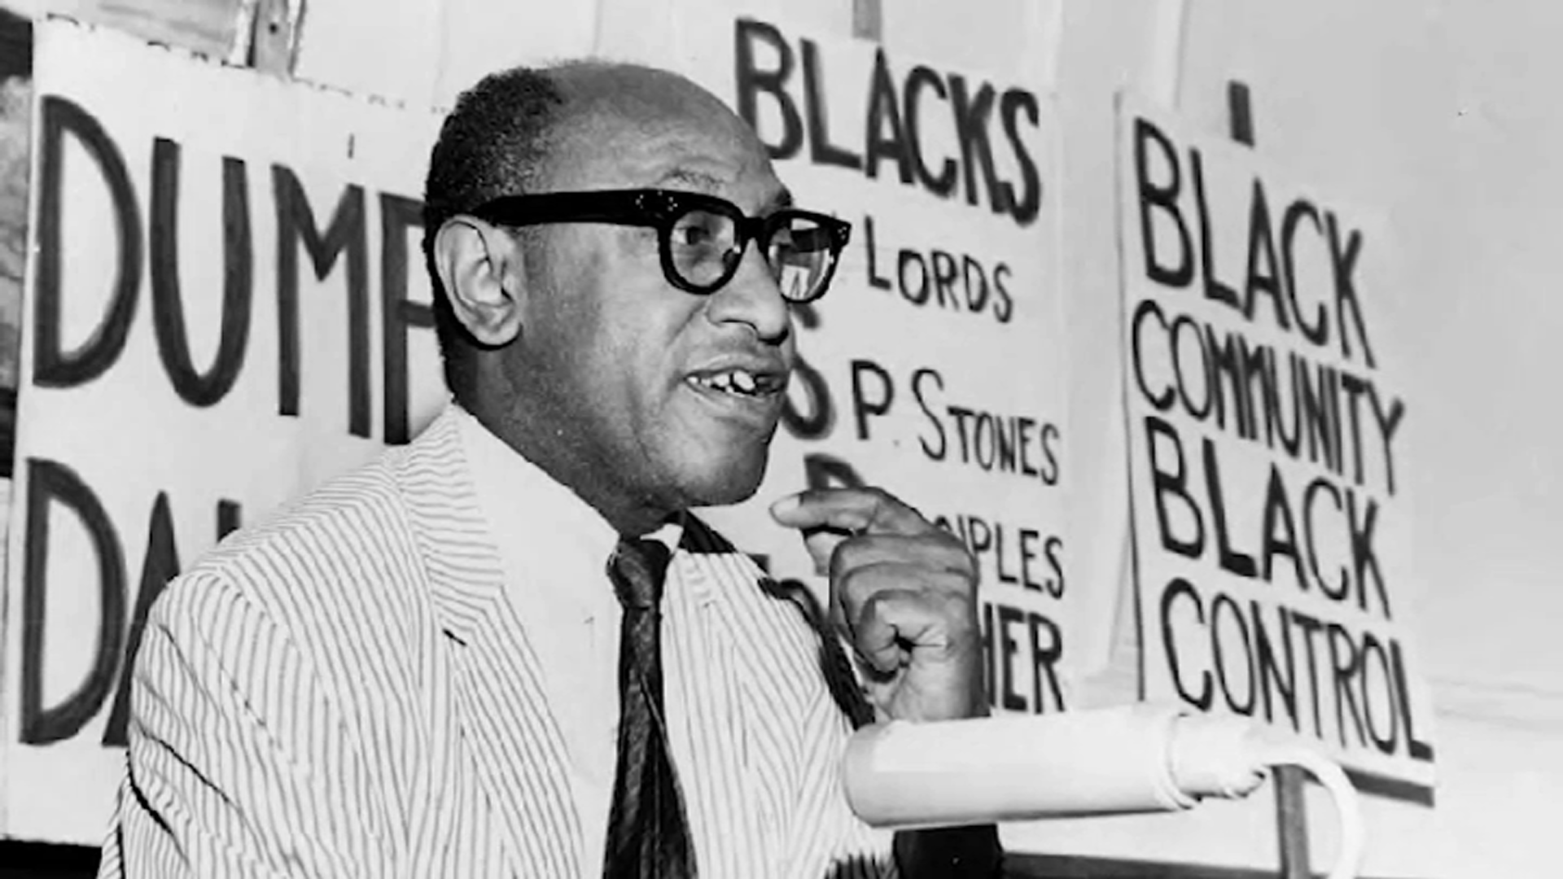
3. Ordeal: power and approach
“The extending of economic values, practices, and metrics to every dimension of human life” has rendered us “individually ‘roving bits of human capital’ where any collective politics become almost unthinkable” (Segal 29)
“I hope he understands that he is the beneficiary of the hopes and dreams of all kinds of Americans carried forward by those of my generation..” (Black 81)
Notes:
Batman is a reinforcement of the connection between capital and collective political action discussed by Segal. He increases his personal value and significance through his capital and only his capital.

Slide 14
Takeaway
It can be liberating and strengthening to view yourself as a superhero, the main character of your life. But it comes at the risk of overlooking your own limits, forgoing personal relationships and the the power of building and relying on your community. Whether our lives resemble Batman or Tim Black’s depends on how we choose to conceive and tell our own narrative, whether it be motivation, relationships or power.

Slide 15
Citations
Hannah Arendt, On Revolution, London, Penguin Books, 1990, p.255
Daniel M. Haybron, Additional Selections on Central Affective States, p.118
Lynne Segal, Radical Happiness, Verso 2018,
Timuel D. Black, Sacred Ground, 2019
Sara Ahmed, The Promise of Happiness, 2010
‘How American History Created the American Superhero’, March 9 2016, humanities.org
Paul Gravett, Superheroes & Propaganda, June 22 2008, paulgravett.com
William Davies, ‘The Age of Pain’, New Statesman, 15 November 2016, newstatesman.com
Michael Eury, ‘superhero’, Britannica, Feb 2017, britannica.com
William Davies, ‘The Political Economy of Unhappiness’, New Left Review, Oct 2011, newleftreview.org

Slide 16
Thank you! / Questions?

